Slide 1
VS
Mary Lin
Alexandra Boonsook
Eric Elizarraraz
Tyler Beauregard

Slide 2
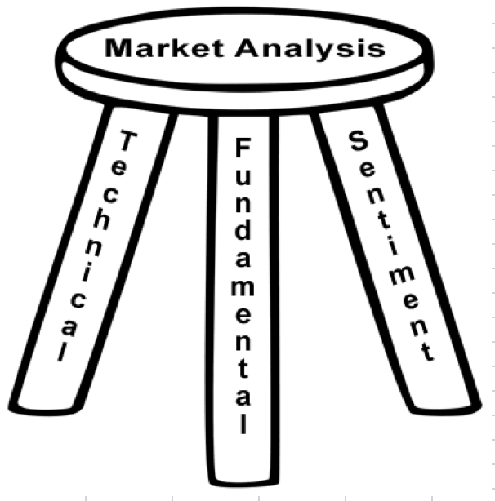
Hypothesis
There is a direct correlation between social media sentiment and cryptocurrency price.

Slide 3
Thought Process
In order to complete this project, we:
Gather sentiment data
Reddit
Reddit API
Praw wrapper
Gather btc prices using API calls
cryptoCompare API
Compare trends, dips and highs

Slide 4
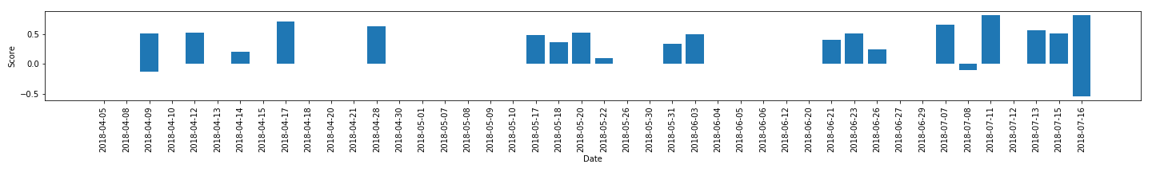
Data Collection
Most difficult challenge was cleaning up and working with the data
Reddit Praw API
Twitter API, tweepy
A lot of bot tweets
Neutral sentiments (as shown in plot)
Hashtags were very unpredictable
Finding reliable data sources

Slide 5
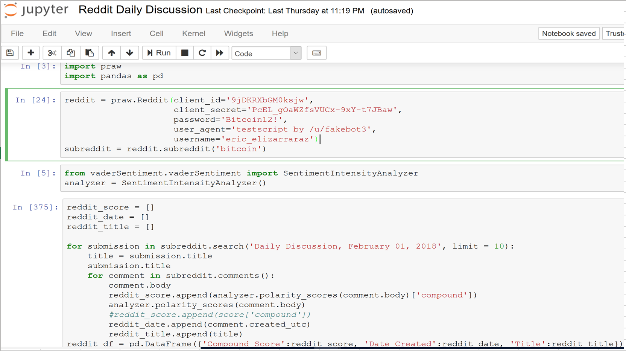
Reddit Scraping

Slide 6
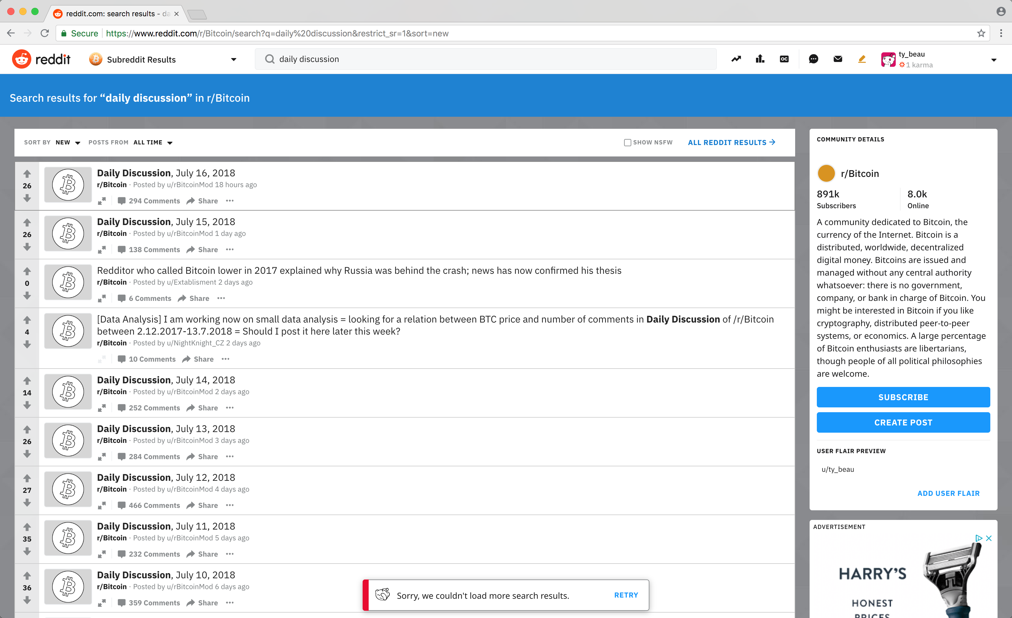

Slide 7
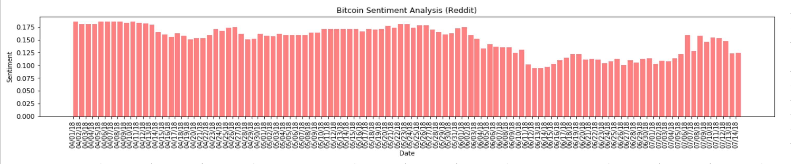
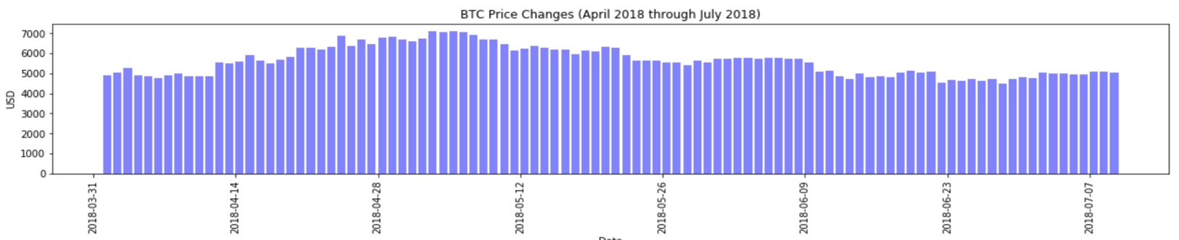
Bitcoin Sentiment Analysis

Slide 8
Conclusion
On the surface, it doesn’t seem like there is very much correlation between the two sets of data.
Could be a result of limited data, or needing more time to clean up the data.
Very obvious and extreme dips and rises in price were reflected in the charts, but was not reflected in day to day

Slide 9
Implications
Sentiment Analysis has it’s usefulness, however, it is not the ultimate investment tool.
In order for proper implementation, more detail information is needed to be able to focus on intra-day fluctuations
Ideally, a streaming data based analysis graph must be constructed in order to be able called an investment tool.

